Slide 1
Going Live

Slide 2
Objectives
In today’s class we will…
Recap the basic topics covered to date
Offer a conceptual introduction to CSS reset and downloadable style sheets
Work with Google Developer tools for site inspection
Utilize Github Pages for website deployment

Slide 3
Check-Up Session
How’s it going?
After 1 week of Bootcamp, how are you holding up?
What feedback do you have so far?

Slide 4
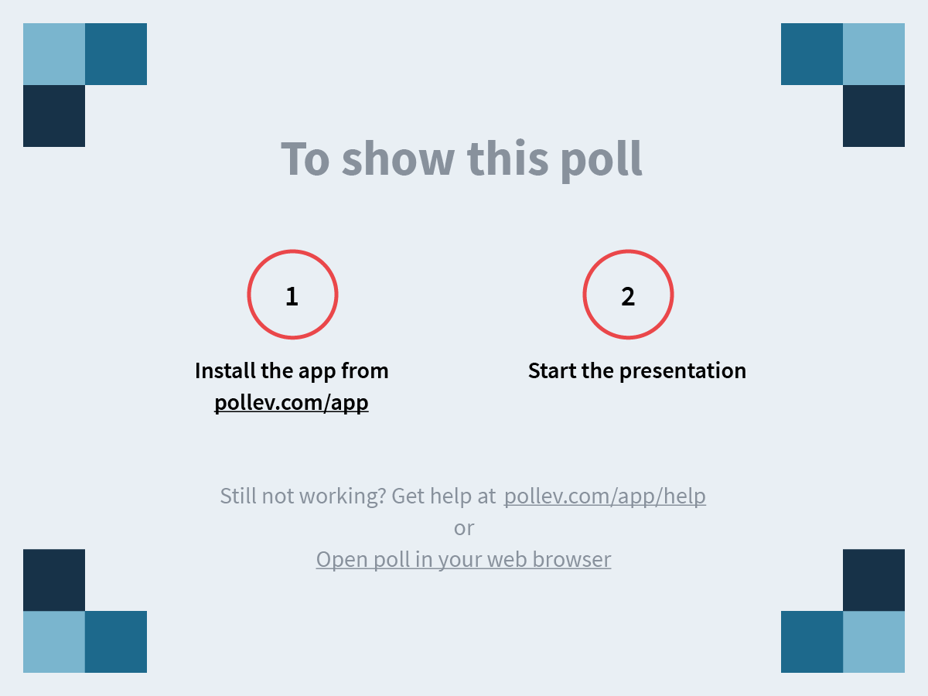
Notes:
What are your thoughts on the pace, content, and challenges of the class? Do you find the lessons going back and forth between html/css and git/command line to be confusing? https://www.polleverywhere.com/free_text_polls/b7zMD0OIvmj0agS

Slide 5

Instructor Feedback
Seriously, mind-blown.

Slide 6
Instructor Feedback
Things I’ve noticed people doing incredibly well:
All of you are handling an enormous volume of information.
All of you are asking the right questions.
You notice the right details.
You all help each other out.
And, most importantly, you are figuring out things on your own.

Slide 7
A Few Admin Things…

Slide 8
Instructor Feedback
Remember, Homework #1 is due on Saturday Oct. 27.
Homework Link: https://gw.bootcampcontent.com/GW-Coding-Boot-Camp/GWAR201810FSF3/tree/master/01-Week/Homework/Instructions
And seriously!
Submit whatever you have! Don’t get a 0.
(Even if you don’t like what you’ve made.)

Slide 9
Office Hours + Additional Help
Also, remember….
In Class Office Hours: 45 minutes before class, 30 minutes after.
Review In Class Material (Exercises and Slides): https://gw.bootcampcontent.com/GW-Coding-Boot-Camp/GWAR201810FSF3/tree/master/01-Week
Re-Watch Class Videos:
https://www.bootcampspot.com/sessions/471444
https://www.bootcampspot.com/sessions/471442
https://www.bootcampspot.com/sessions/471440

Slide 10
Recapping

Slide 11

Recap
In just one whirlwind week we’ve covered:
Full-Stack Development Conceptually
Terminal / Git Bash
HTML Syntax
Git Concepts and Commands
CSS Purpose, Syntax, and Styles
Floating
Positioning
Box Model
Chrome Dev Tools
How to Learn on Your Own!!

Slide 12

Full-Stack Development?

Slide 13

> Intro to Console

Slide 14

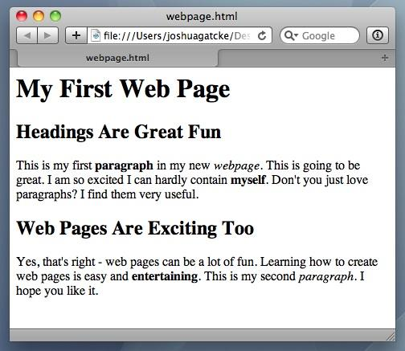
<title> Intro to HTML </title>
HTML is one of the three base languages behind every single website.
It defines all of the basic content and a bit of formatting.

Slide 15





Pushing and Pulling to GitHub
1
2
3
4
GitHub Branch
Pull Code
Push Code
Pull Code
Pull Code
Push Code
Pull Code
Push Code

Slide 16

CSS Syntax
CSS works by hooking onto selectors added into HTML using “classes and identifiers”.
Once hooked, we apply styles to those HTML elements using CSS.

Slide 17

The Concept of “Flow”
In HTML/CSS, (by default) every element displayed is governed by a concept called “flow.”
This means that HTML elements force their adjacent elements to flow around them.

Slide 18
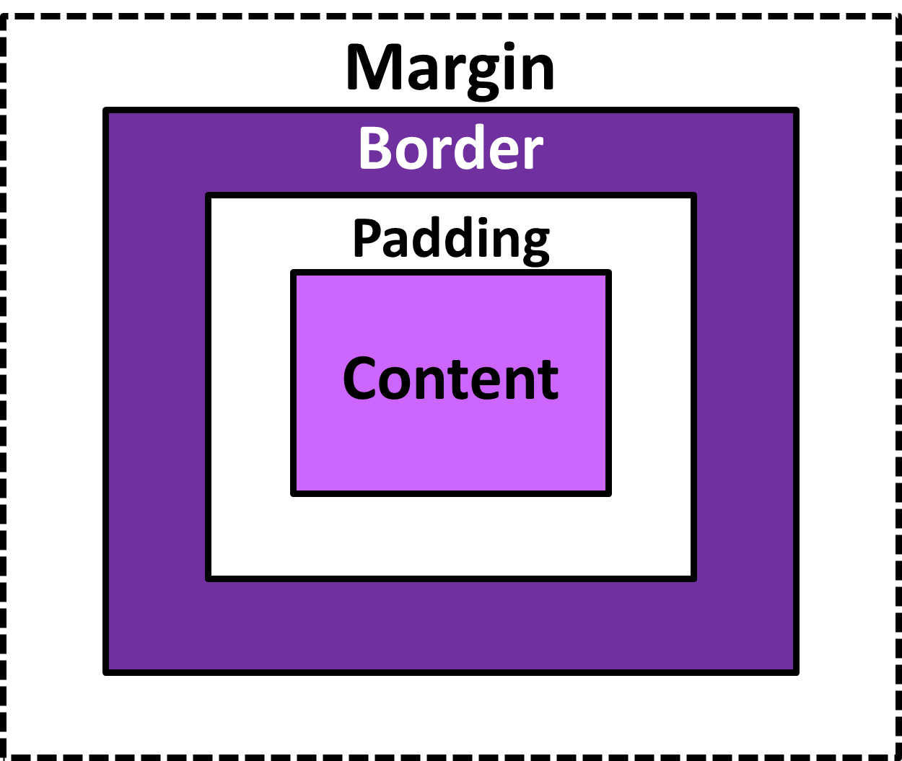
The Box Model
The Box Model wraps every CSS element in padding, border and margin – allowing developers to modify spacing styles.

Slide 19

CSS Positioning
We can orient our HTML elements in relation to space with CSS positioning (static, relative, fixed, absolute).

Slide 20









How to Learn…

Slide 21

General Questions / Issues?

Slide 22
Double Take

Slide 23
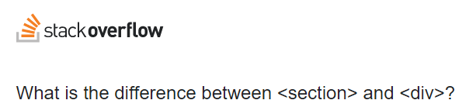
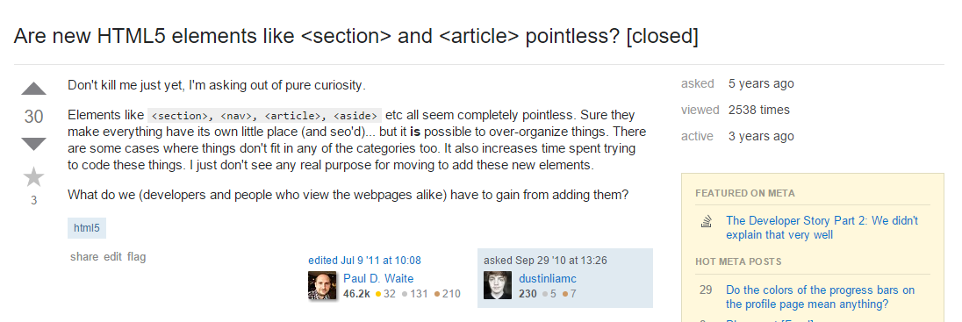
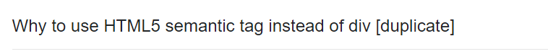
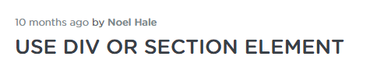
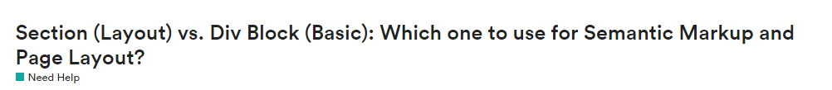
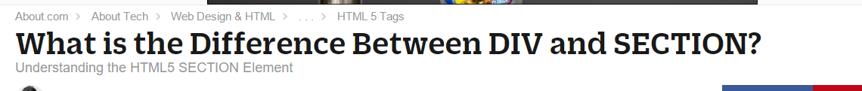
Divs, Sections, Navs, Etc….

Slide 24
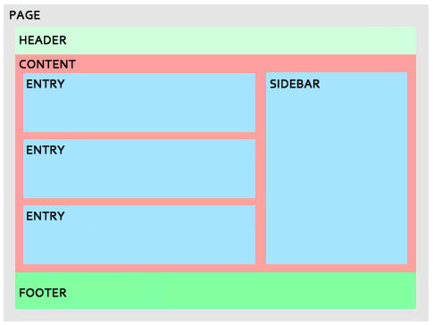
Divs, Sections, Navs, Etc….
All web layouts are inherently composed of containers, traditionally called “divs.”

Slide 25
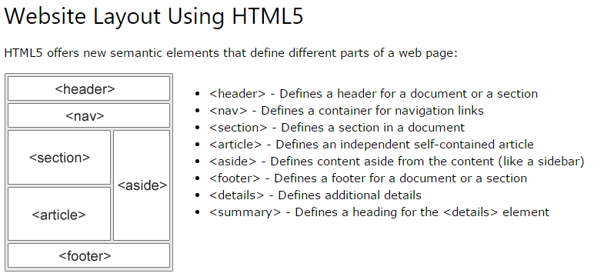
Divs, Sections, Navs, Etc….
HTML5 introduced the concept of “semantic layouts,” meaning “divs” could be given more meaningful names.
In theory, this helps with organization and search engine optimization.

Slide 26
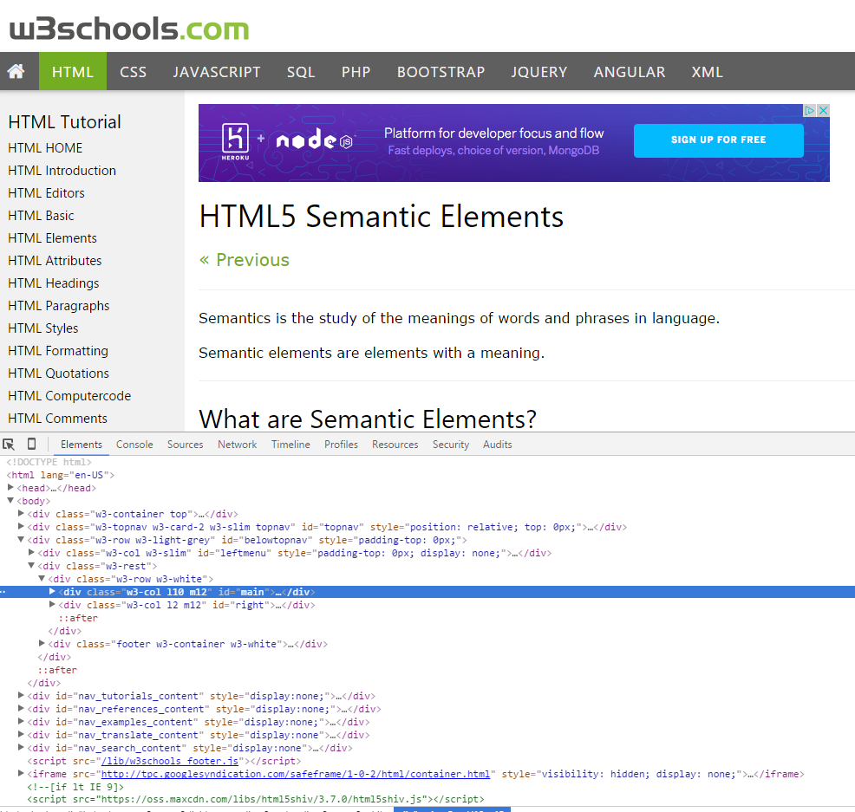
Divs, Sections, Navs, Etc….
That said… many (if not most) websites, seem to still be using basic divs.
There are reasons for this that we’ll showcase in later sections.
Additionally, it’s possible to include “semantics” by using id names and classes.

Slide 27
Divs, Sections, Navs, Etc….
div?
Section?
Bottom line: Follow your homework’s instructions. But when you get out in the “real world,” follow the convention of where you work!

Slide 28

Classes vs. IDs
Classes = Barcode (all iPod)
IDs = Serial Number (unique iPod)
When choosing between a CSS ID and a CSS Class follow the convention:
Classes (.classname) are to be used if the same style will be used on multiple HTML elements.
IDs (#idname) are to be used if a style is unique to that HTML element.

Slide 29
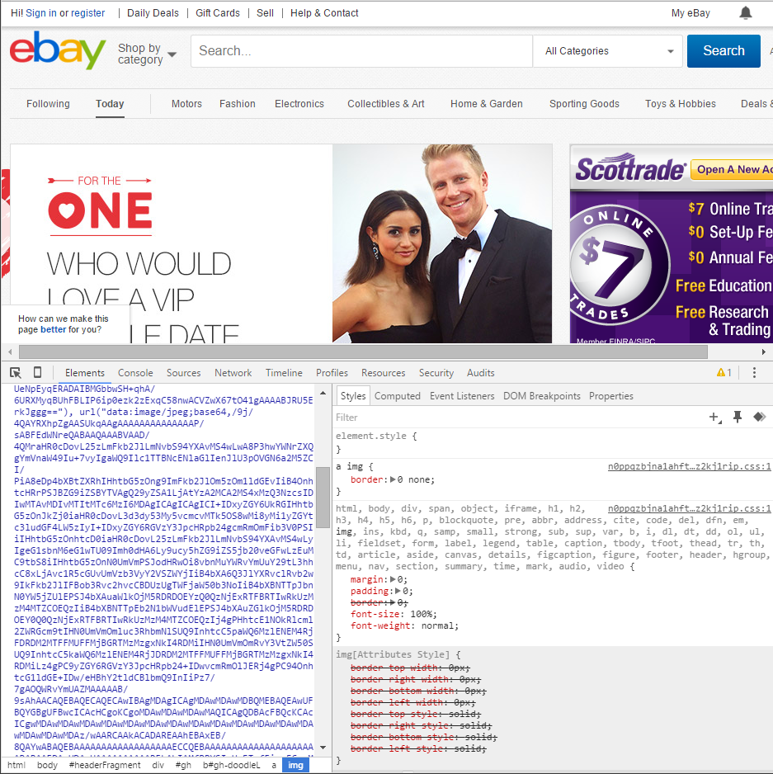
Chrome Developer Tools (Inspector)
This is one of the most frequent tools you will use in web development.
It allows you to truly debug your web designs.
Start using it!

Slide 30

Modifying Sites
You can edit any page’s HTML and CSS with Chrome Developer Tools.
Plus, you’ll see your results instantly.

Slide 31
INSTRUCTOR DEMO!
Instructor: Demo
(Chrome Developer Tools)
Notes:
‹#›

Slide 32
> YOUR TURN!!
Suggested Time: 15 min
Assignment
For the next 15 minutes, take a website you commonly use (Amazon, Google, Huff Po, etc.) and heavily modify it using the Chrome Developer Tools.
Be sure to at least modify:
Content (Change words)
Colors
Spacing
Send a screenshot to the class’s slack profile when you’re done.

Slide 33
> YOUR TURN!!
Suggested Time: 10 min
Assignment
For the next 10 minutes, edit any site that you’ve been working on in-class or for homework with Chrome Developer Tools.
Be sure to at least modify:
Content (Change words)
Colors
Spacing

Slide 34
CSS Resets

Slide 35

Loading Multiple CSS Files ***(Very Important!!!)***
An incredibly powerful technique: deploying multiple CSS files simultaneously.
This lets developers to create complex designs made up of abounding design elements.
Just remember: the loading order matters!!!

Slide 36
INSTRUCTOR DEMO!
Instructor: Demo
(1-3_CSSFiles.html | 3-MultipleCSS)
Notes:
‹#›

Slide 37
What Browser?
By a show of hands…
Which browser do you use?

Slide 38

Battle of the Browsers
Under the hood, web browsers often render web pages differently than their competition.
These disparities could mean HTML/CSS displaying differently in each web client.
Because of these potential divergences, web developers need to make their websites cross-browser compatible.

Slide 39

Reset.css (or Normalize.css)
Reset.css will “reset” all browser-specific CSS. This means your site will appear the same in all browsers.
However, you will have to re-style everything yourself.

Slide 40
INSTRUCTOR DEMO!
Instructor: Demo
(Example.html | 4-ResetCSS)
Notes:
‹#›

Slide 41
Why CSS Resets Matter
It’s important for creating browser-compatible websites
It’s an example of using someone else’s CSS in your website!!!
It’s a common Front-End Developer Interview question.

Slide 42
> YOUR TURN!!
Suggested Time: 10 min
Assignment
Follow the instructions given via Slack to incorporate a reset.css file into a basic HTML file.
Note the impact the reset file makes after its inclusion.

Slide 43
To the Web with GitHub!

Slide 44
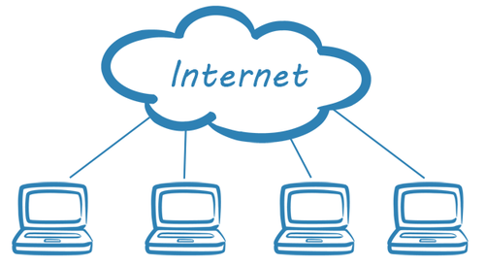
The Internet
A deep and complex diagram above on how the internet works.

Slide 45

The World Will See Our Greatness!
GitHub provides hosting for static websites – which means we can deploy our websites and applications onto their servers for the world to see.

Slide 46
Together Now…
Let’s all login to GitHub

Slide 47
INSTRUCTOR DEMO!
Instructor: Demo
(GitHub Pages Deployment - Personal)
Notes:
‹#›

Slide 48
Deploying Static Personal Site – GitHub Pages
Basic Steps:
Create a new repo that is named `_username_.github.io`
Navigate into a folder and clone the repo into it
Build your files
Add, commit, and push your changes into the repository

Slide 49
> YOUR TURN!!
Suggested Time: 15 min
Assignment
Time to take your newfangled website and deploy it to the cloud (in this case, GitHub Pages).
Additional instructions to be sent via Slack.

Slide 50
INSTRUCTOR DEMO!
Instructor: Demo
(GitHub Pages Deployment - Project)
Notes:
‹#›

Slide 51
Deploying a Static Project Site – GitHub Pages
Basic Steps:
1. Create a new repository on your GitHub account. You can name this repository whatever you would like.
2. Once inside of the repository, create a new file and name it `index.html`
3. Add some very basic HTML into this file, save it, and then navigate into your repository's Settings tab.
4. Scroll down to the GitHub Pages section and then, in the section labeled "Source", select that you would like to use the master branch as your source.
5. Navigate to `<username>.github.io/<repositoryname>` and you will find that your new web page has gone live!

Slide 52
> YOUR TURN!!
Suggested Time: 15 min
Assignment
Build a newfangled website, and deploy it to GitHub Pages as a project instead of a personal site.
Additional instructions to be sent via Slack.

Slide 53
Practice Through Frustration
Keep Practicing!
It gets better.

Slide 54
Questions?

Slide 55
Homework 1 - Help?

Slide 56
EXTRA MATERIAL

Slide 57
And Back to Git…

